Slide 1

Publication Ready LaTeX Tables in Stata
Using TexResults2
Gabrielle Sorresso (gns36)
CCSS Workshop March 4th, 2024

Slide 2
Workshop Outline
01
02
03
04
Introduction LaTeX
& Texresults2
Stata
Demonstration
LaTeX Demonstration in Overleaf
Bonus
Content

Slide 3
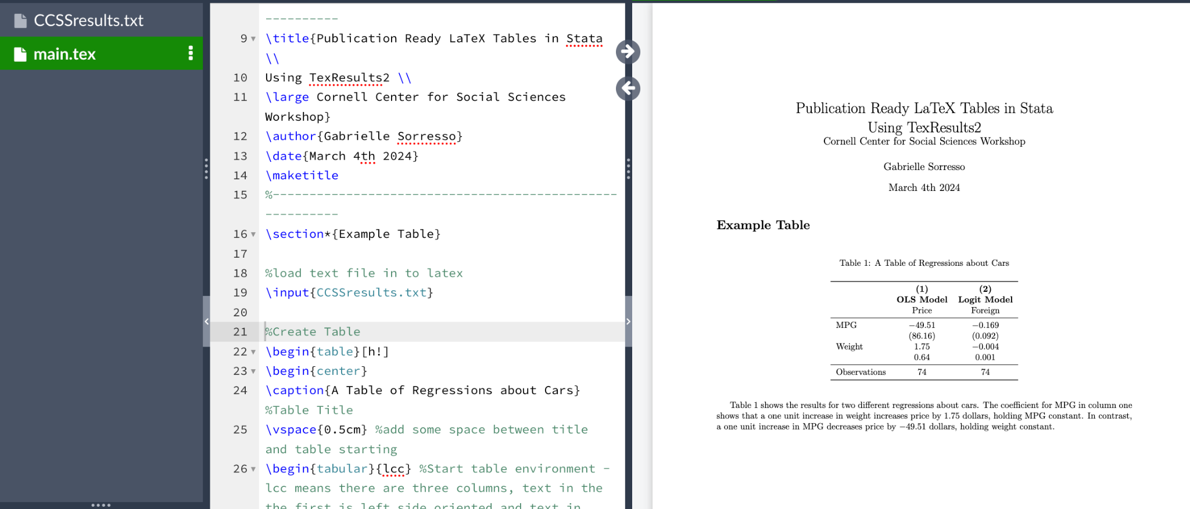
What is LaTex?
A software for creating documents - however, unlike MS Word, users edit the LaTex markup side to describe the document and its features
Then a PDF (which can not be directly edited by the user) is compiled
Commonly used in academia – has many benefits such as:
Nice Table Creation Features
Citation management system
Easy mathematical symbols
We will use Overleaf to access LaTex– an online LaTex editor

Slide 4
Can I use Stata and LaTeX Together?
There are a number of different packages you can use that can integrate Stata output (generally as a tables) that is usable in LaTex documents
Generally these commands output premade text to create a LaTeX table
Examples include: estout and outreg2
Or allow you to create macros that hold estimation results so you can create your own table in LaTeX
Examples include: Texresults2!

Slide 5
Why work in this way?
Allows for Automation
Reduces
Error
Publication Standard
Saves users valuable time by reducing manual table creation
Eliminates human error from inputting numbers into a table manually
Many journals require manuscripts to be submitted in LaTex

Slide 6
What is TexResults2?
Texresults2 is a Stata package that allows users to create text files containing LaTeX Macros that store estimation results (like regression coefficients)
The text file which can be uploaded to LaTex and the Macros can be referenced in a user created LaTeX table or in text
It builds on the original package (TexResults by Alvaro Carril) but fixes previous bugs and adds functionality

Slide 7
Advantages of TexResults2?
Main advantages of Texresults2 over packages like estout and outreg2:
Complete flexibility in table creation
Ability to reference macros in text
One clear disadvantage:
High fixed cost of setting up table (although AI can help!)

Slide 8
How to use TexResults2?
After an estimation command (generally a regression) the user can run:
texresults2 using {filename}, texmacro(macroname) resulttype(coefficient or scalar name) replace/append [{options}]
filename: name for your text file
macroname: name for your result you are exporting
This is how you will reference this result in LaTex
resulttype: What are you exporting? Coefficient, standard error, etc
More on next slide
replace/append: are you starting a new text file for the first time in a Do-File (replace) or do you want to add to an existing text file (append)

Slide 9
What Result Types Exist?
result - this is the most general result type, use this to export any scalar stored in Stata
coef - coefficient
se - standard error
tstat - t-statistic
pvaluez - p -value
ubz or lbz - upper or lower bound value in 95% confidence interval
Note: Include the z option when using a regression type where inference is based on a z-distribution instead of a t-distribution
(like logit and probit models)

Slide 10
Any other options I should know?
texresults2 using {filename}, texmacro(macroname) resulttype(coefficient or scalar name) replace/append [{options}]
Another useful option is round(#) - which will round your result to any desired number of decimal places
So round(3) - would round to the nearest thousandth
And round(0) - would have no decimal places
The default is two decimal places

Slide 11

Let’s move to Stata for a demo!

Slide 12
Some LaTex Resources:
Overleaf - Learn LaTeX in 30 Minutes
Overleaf Tutorials
Link Overleaf and Dropbox (requires premium)
David Wilkins Getting Started with LaTeX Guide

Slide 13
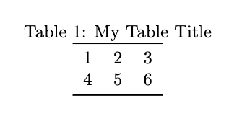
LaTeX Table Basics
\begin{table}[]
\begin{center}
\caption{My Table Title}
\begin{tabular}{lcc}
\toprule
1 & 2 & 3 \\
4 & 5 & 6 \\
\bottomrule
\end{tabular}
\end{center}
\end{table}

Slide 14
LaTeX Table Basics
\begin{table}[]
\begin{center}
\caption{My Table Title}
\begin{tabular}{lcc}
\toprule
1 & 2 & 3 \\
4 & 5 & 6 \\
\bottomrule
\end{tabular}
\end{center}
\end{table}
Start and end table
Center table on page
Add a title to your table

Slide 15
LaTeX Table Basics
\begin{table}[]
\begin{center}
\caption{My Table Title}
\begin{tabular}{lcc}
\toprule
1 & 2 & 3 \\
4 & 5 & 6 \\
\bottomrule
\end{tabular}
\end{center}
\end{table}
Start “table” part of table
(rows and columns part)
The lcc tells LaTex this table has three columns, text in the first is left centered and text in the second two are centered
Add lines above and below table
Table content
& separates columns and \\ denotes the end of a row

Slide 16


